Slide 1
Numeracy and Decision Making
Joselyn Hathaway-Undergraduate Researcher
Dr. Michael Serra-Mentor

Slide 2
Background
Numeracy
The ability to understand and work with numbers
Low vs. High Numeracy
An individual’s level of understanding of numerical concepts
Measurement of someone's level of numeracy
Notes:
Numerate- able to efficiently understand number representation
Innumerate- lower ability to efficiently understand number representation

Slide 3
Background (cont.)
Low numerate people will make poorer decisions than higher numerate people
Individuals level of numeracy can affect their judgment and decision making

Slide 4
Purpose
The purpose of this research is to identify:
Numeracy
Importance
Role in every day life

Slide 5
Questions
How does numeracy relate to decision-making?
Does numeracy relate to reaction times?
Notes:
Split of data from both scales*

Slide 6
Variables
Participant Variable (non-manipulated)
High vs. low numeracy
Independent Variables
Vary by study
Ex. Positive vs. negative frame
Ex. Frequency vs. percent
Dependent Variables
Choices and ratings in risk and decision making task
Reaction time (completion time per task)

Slide 7
Methodology
Replication
Numeracy and Decision Making
Peters et al. (2006)
Single sample
Expanded numeracy measure
MTURK survey
Payment of 20¢ (regardless of completion)

Slide 8
Methodology (cont.)
Numeracy measures
Lipkus Scale (11 questions)
Berlin Scale (4 questions)
Judgment and decision tasks
Attribute framing (correct vs. incorrect)
Risk representation
Affective information
Affect and Betting
Notes:
Lipkus- probability, chances, open-ended, single answer
11 questions
Berlin- probability, chances, multiple choice, single answer
4 questions

Slide 9
Lipkus Scale
Ex. Chances of a disease
Notes:
Wrong or right answer
Probability and chance

Slide 10
Berlin Scale
Ex. Rolling a die
Notes:
Multiple choice
Probability and chance

Slide 11
Expected Result
There will be an interaction between numeracy and the manipulations
High numerate participants responses will depend on their logical thinking (replicated results/interaction)
Low numerate participants responses will depend on affective information(replicated results/interaction)
High numerate people will answer faster(new results)

Slide 12
Study 1-Attribute Framing
Participants rated the performance of a students test grades
Rating scale ran from “very poor” to “very good”
Participants given the percent correct or incorrect of the students test score

Slide 13
Study 1-Attribute Framing
Results:
High numerate participants rated the students’ grades significantly lower than did the low numerate people
Participants took longer to respond with the the incorrect frame
Interaction was not significant

Slide 14
Study 2-Risk Representation
Participants given a vignette of a mental health patient
Participants were to rate the level of risk of the patient committing an act of violence
Rating scale ran from “very low risk” to “very high risk”
Participants given the level of risk as a percent or a frequency

Slide 15
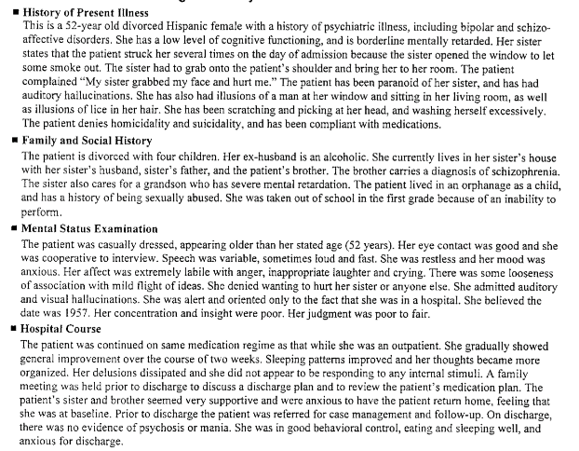
Vignette of Mental Health Patient

Slide 16
Study 2-Risk Representation
Results:
Reaction time for high numerate was higher (opposite of expectation)
Interaction was not significant

Slide 17
Study 3-Affective Information
Participants given two jars of jellybeans
Jar A
9 red jellybeans out of 100
Jar B
1 red jellybean out of 10
Participants chose which jar they believed had the higher chance of them picking a red jellybean

Slide 18
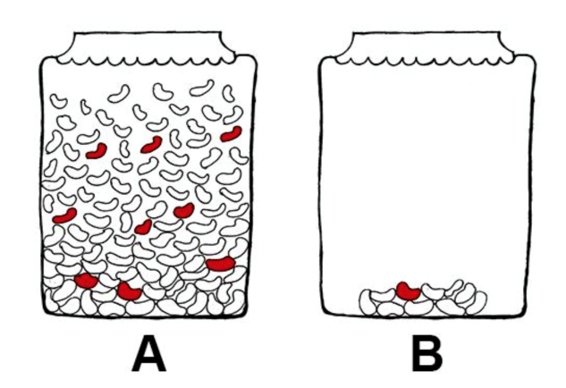
Jar of Choice

Slide 19
Study 3-Affective Information
Results:
High numerate participants were more likely to choose the jar with fewer jelly beans (greater chance of winning) than were the low numerate participants
High numerate took longer to respond (opposite of expectation)
Interaction was not significant

Slide 20
Study 4-Affect and Betting Loss vs. No Loss Bet
Participants given a small loss or no loss bet
No loss bet
7/36 chance to win $9 or 29/36 chance to win nothing
Small loss bet
7/36 chance to win $9 or 29/36 chance to lose $0.05
Participants rated the attractiveness of the bet on a scale from “0- not attractive at all” to “20-extremely attractive”

Slide 21
Study 4-Affect and Betting
Results:
High numerate we affected by affective information
Participants rated a bet involving a small potential loss as more attractive than a bet involving no chance of a loss
Reaction time was higher and more significant for high numerate
Replication of loss bet over no loss bet

Slide 22
Conclusion
The interactions were not there but the main affects were replicated
Using a the split halves and tertiary split did not come out correct
Data was evenly distributed
Distribution was not wide enough
Low numerate were not low enough
Notes:
The split haves of the data was even and interaction was not there and evenly distributed
Not a wide enough distribution
Low numerate people were not low enough
-how to get more low numerate people
-need younger participants
-lower education level
-tertiary spilt or find a way to spread the participants apart
-continuous analysis

Slide 23
Conclusion (cont.)
The response times were more significant for high numerate participants (opposite expectation)
High numerate participants had more time thinking over the questions
Solutions
Continuous analysis
Younger participants
Lower education level

Slide 24
Acknowledgements
Dr. Michael Serra for guiding and assisting me on my ongoing research process
Principal investigator Dr. Pat DeLucia and the co-principal investigator Dr. James Yang for providing me with the funding and opportunity for my research experience
TTU staff and presenters for their knowledge and resources essential for my research
This material is based upon work supported by the National Science Foundation under Grant No. 1559393

Slide 25
References
Peters, E., Västfjäll, D., Slovic, P., Mertz, C., Mazzocco, K. and Dickert, S. (2006). Numeracy and Decision Making. Psychological Science, 17(5), pp.407-413.
Peters, E. (2012). Beyond Comprehension. Current Directions in Psychological Science, 21(1), pp.31-35.
McGraw, A., Larsen, J., Kahneman, D. and Schkade, D. (2010). Comparing Gains and Losses. Psychological Science, 21(10), pp.1438-1445.
Slovic, P., Monahan, J. and MacGregor, D. (2000). Violence risk assessment and risk communication: The effects of using actual cases, providing instruction, and employing probability versus frequency formats. Law and Human Behavior, 24(3), pp.271-296.
Cokely, E., Galesic, M., Schulz., Ghazal S., and Garcia-Retamero, R. (2012). Measuring Risk Literacy: The Berlin Numeracy Test. Judgement and Decision Making, 7(1), pp. 25-47.

Slide 26
QUESTIONS?

